Slide 1
Memento
Alex Kohan
Darida Razvan

Slide 2
Memento is a behavioural design pattern that lets you save and restore the previous state of an object without revealing the details of its implementation.

Slide 3



Slide 4
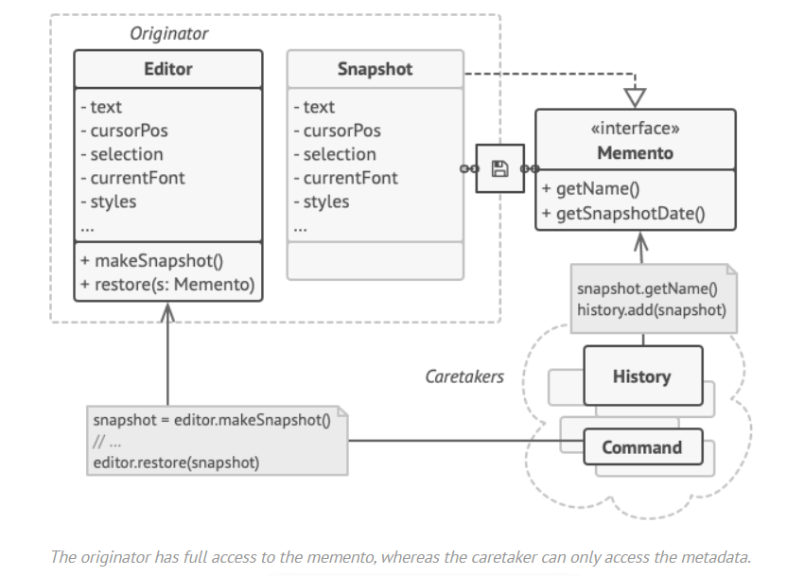

Slide 5

Applicability
You are able to save and restore the previous state of an object using snapshots.

Slide 6
While most people remember this pattern thanks to the “undo” use case, it’s also indispensable when dealing with transactions (i.e., if you need to roll back an operation on error).

Slide 7
Use the pattern when direct access to the object’s fields/getters/setters violates its encapsulation.

Slide 8
Pros and Cons
✓ You can produce snapshots of the object’s state without violating its encapsulation.

Slide 9
✓ You can simplify the originator’s code by letting the caretaker maintain the history of the originator’s state.

Slide 10
✗ The app might consume lots of RAM if clients create mementos too often.

Slide 11
✗ Caretakers should track the originator’s lifecycle to be able to destroy obsolete mementos.

Slide 12

Most dynamic programming languages, such as PHP, Python and JavaScript, can’t guarantee that the state within the memento stays untouched.

Slide 13
Relations with Other Patterns
You can use Command and Memento together when implementing “undo”. In this case, commands are responsible for performing various operations over a target object, while mementos save the state of that object just before a command gets executed.

Slide 14
You can use Memento along with Iterator to capture the current iteration state and roll it back if necessary.

Slide 15
Sometimes Prototype can be a simpler alternative to Memento. This works if the object, the state of which you want to store in the history, is fairly straightforward and doesn’t have links to external resources, or the links are easy to re-establish.

Slide 16
Usage of the pattern in Java
All java.io.Serializable implementations can simulate the Memento.
All javax.faces.component.StateHolder implementations.

